Slide 1
SQL Challenge: Day 1
100 days of SQL challenge
Pardha Saradhi kanumuri

Slide 2
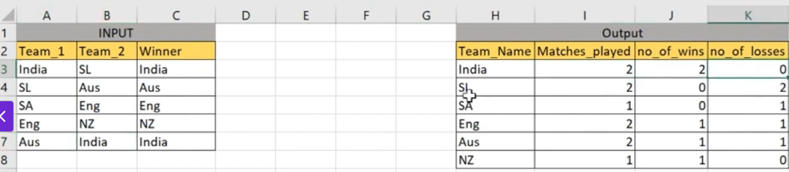
Problem:
You are given a table match_results with columns team1, team2, and winner. Each row represents a match between two teams and the winner.
Task:
Write an SQL query to generate a points table showing:
Team Name
Total matches played
Number of wins
Number of losses
#100DaysOfSQLChallenge

Slide 3
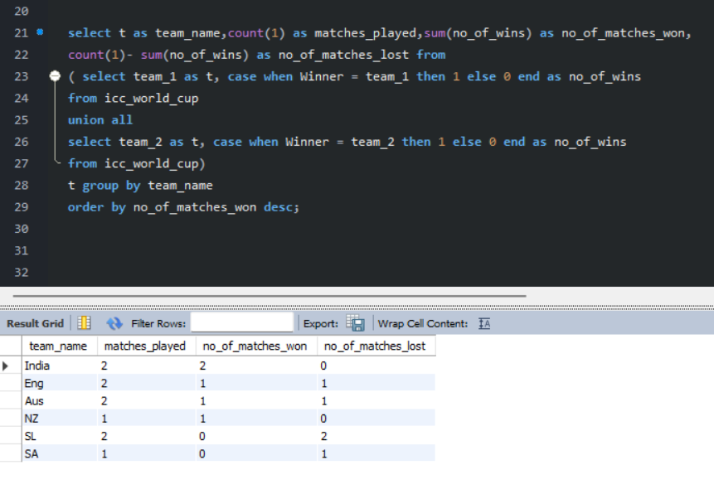
Goal:
Create a points table showing matches played, wins and losses.
It’s taking some time to find the right direction, but I feel like I’m on the right track.
#100DaysOfSQLChallenge

Slide 4
How I Approached It – Day 1
When I looked at the problem, the first thing I noticed was that each match had two separate team columns. To analyze all teams together, I combined them into a single list using UNION ALL.
Next, I needed a way to identify which team won each match, so I used conditional logic (CASE WHEN) to assign a win to the correct team.
After preparing that, I summarized the results by team using GROUP BY to calculate matches played, matches won, and matches lost.
Finally, I arranged the output so the top-performing teams appear first using ORDER BY.
#100DaysOfSQLChallenge

